Slide 1
CSE 110: Programming Language I
Matin Saad Abdullah
mabdullah@bracuniversity.net
UB 1222

Slide 2
Non-Sequential
Program Statements
Programs that execute only sequential program statements are pretty simplistic.
Most programs need more flexibility in the order of statement execution.
The order of statement execution is called the flow of control.
Control statements allow the execution of statements based upon decisions.

Slide 3
Class task
Ask the user for two numbers and show the user the larger of the two numbers.

Slide 4
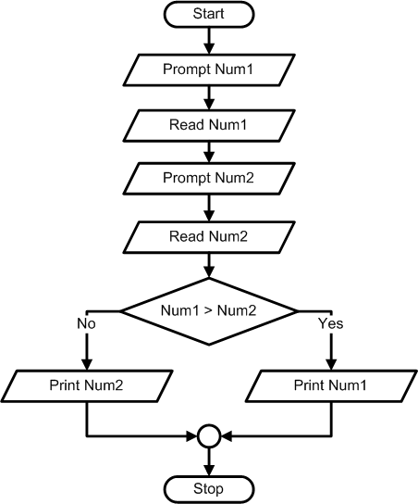

Slide 5
Flow Control Design Tool: Flowcharts
Flowchart - a graphical way of writing algorithms
  Rectangle is used for calculations
  Parallelogram is used for input and output
  Circle is used as connector
  Diamond is used as decision
  Symbols are connected by arrows to represent the order of the operations

Slide 6
Flowchart Selection Algorithm
Real World Problem:
  Calculate one child’s allowance, based upon 75 cents per year old if s/he is under 10, and $1 per year if 10 or over.

Slide 7
Flowchart Selection Algorithm
Real World Problem:
  Calculate one child’s allowance, based upon 75 cents per year old if s/he is under 10, and $1 per year if 10 or over.
Known Values
  YoungRate = 75 cents per year
  OlderRate = 100 cents per year
  BreakAge = 10
Inputs
  Age of child
Calculations
  Allowance = Age x Rate
Outputs
  Allowance

Slide 8
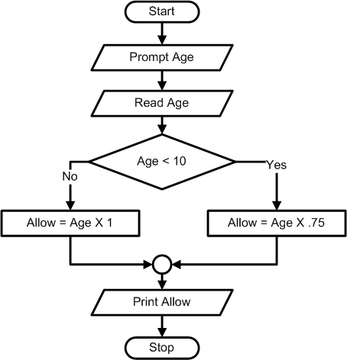

Slide 9
Class task
Draw a flowchart of a program that reads two numbers from the user and prints “first” if the first number is greater than the second number.

Slide 10
Class task
Draw a flowchart of a program that reads two numbers, subtracts the smaller number from the larger one, and prints the result.

Slide 11
Class task
Draw a flowchart of a program that reads one number form the user and prints “odd” if the number is odd and prints “even” if the number is even.

Slide 12
Class task
Draw a flowchart of a program that reads a number, and prints the number if it is a multiple of 2 and 5.
  For example: 10, 20, 30, 40, 50 …

